Slide 1
Ai based Diabetes prediction system
Submitted by M.Reddappa Reddy dept: Ai and Ds reg no : 723921243035

Slide 2
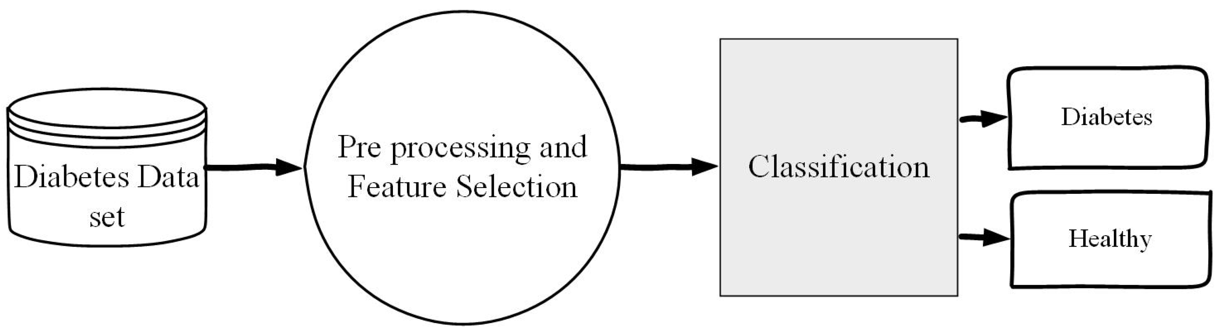
AI-Based Diabetes Prediction System
Problem Statement
The goal of this project is to develop an AI-based Diabetes Prediction System that can accurately predict whether an individual is likely to develop diabetes or not. Diabetes is a prevalent and chronic medical condition with significant health implications, and early diagnosis can lead to better management and improved patient outcomes. This system should leverage machine learning and artificial intelligence techniques to analyze relevant medical data and provide predictions.

Slide 3

Project Objectives
Data Collection:
Gather relevant data from various sources, including electronic health records, clinical datasets, and medical research. This data should include patient demographics, medical history, lifestyle factors, and diagnostic tests results.

Slide 4
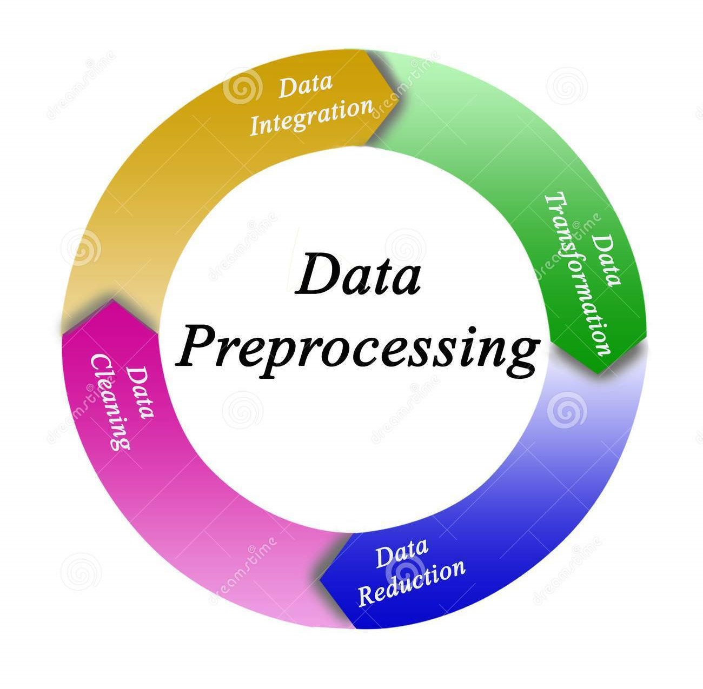
2.Data Preprocessing:
Clean, preprocess, and standardize the collected data to make it suitable for machine learning model training. This includes handling missing values, data transformation, and feature engineering.

Slide 5
3.Model Development:
Develop a machine learning model, potentially based on deep learning techniques, that can predict the likelihood of an individual developing diabetes. The model should be trained on historical data and be capable of making accurate predictions.
4.Model Evaluation:
Evaluate the model's performance using appropriate metrics such as accuracy, precision, recall, F1-score, and AUC-ROC. Fine-tune the model and optimize it for best results.
5.User Interface:
Create a user-friendly interface for the system, which could be a web application, mobile app, or integrated into an electronic health record system.

Slide 6
6.Integration with Health Systems:
Ensure that the system can seamlessly integrate with healthcare systems for real-time data exchange and patient record updates.
7.Security and Privacy:
Implement strong security measures to protect patient data and ensure compliance with data protection regulations like HIPAA.
8.Scalability:
Design the system to be scalable, accommodating an increasing volume of patient data and users.
9.Explainability:
Ensure the model's predictions are explainable, providing insights into why a particular prediction was made. This is crucial for gaining the trust of healthcare professionals and patients.
10.Regulatory Compliance:
Ensure the system complies with relevant medical and data privacy regulations in the target region.

Slide 7
Conclusion
The AI-Based Diabetes Prediction System is a critical tool in improving diabetes diagnosis and management. By following the above approach, we aim to develop a robust and trustworthy system that can positively impact patients' lives and healthcare outcomes. It is essential to collaborate with healthcare experts and regulatory authorities to ensure the success of this project.

